Slide 1
Text Mining
L09. Sentiment Analysis

Slide 2
Today’s lecture
Quiz about week 8
Sentiment analysis
Concepts of sentiment analysis
Annotation
Aspect-based sentiment analysis
Challenges
Evaluation
Example case: sentiment analysis for tweets (SemEval 2018)
Introduction of final assignment

Slide 3
Quiz about week 8
What is the difference between extractive and abstractive summarization?
Extractive summarization methods are feature-based and abstractive summarization methods are neural-network-based
Extractive summarization methods compose the summary from nuggets in the original text and abstractive summarization methods generate a new text
Extractive summarization methods summarize a whole document and abstractive summarization methods summarize a single sentence

Slide 4
Quiz about week 8
Why is the LEAD-3 baseline difficult to beat in commonly used benchmark sets?
Benchmark sets often consist of newspaper texts and in newspaper articles, the most important information is in the beginning of the text
Because the training data is not sufficiently diverse
Because the sentences with the highest centrality are the most representative of the text

Slide 5
Quiz about week 8
What is the common metric for evaluating (abstractive) evaluation? How is it defined?
BLEU: the precision of n-grams in the automatically generated summary compared to the reference summaries
BLEU: the recall of n-grams in the automatically generated summary compared to the reference summaries
ROUGE: the precision of n-grams in the automatically generated summary compared to the reference summaries
ROUGE: the recall of n-grams in the automatically generated summary compared to the reference summaries

Slide 6
Quiz about week 8
Which of these statements is true?
Extractive summarization leads to more fluent summaries than abstractive summarization
Abstractive summarization can be modelled as a translation task
Extractive summarization is always a supervised learning task

Slide 7
Sentiment analysis

Slide 8
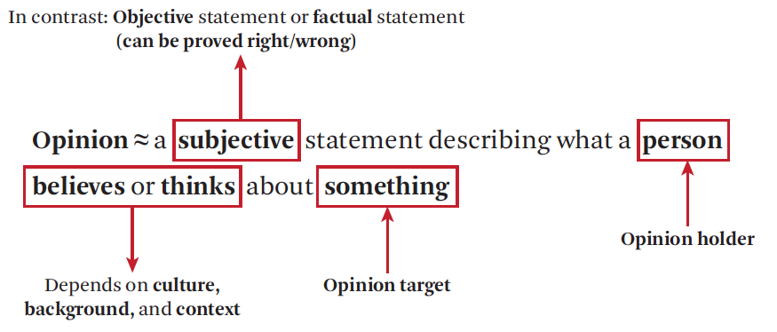
Sentiment analysis and opinion mining
Booming research area since 2000s
Connected to the rise of social media: the place for expressing personal and subjective opinions
Zhai & Massung, 2016
Notes:
definition of the book in chapter 18: opinion mining
covers the broad task of detecting the opinions and sentiments of people towards entities, events or topics in text

Slide 9
Sentiment related tasks
Opinion mining, sentiment classification, sentiment mining, subjectivity analysis, affect analysis, emotion detection, stance detection, …
Sentiment expressions are a subset of subjective language use
E.g. “I think he went home” = subjective but no sentiment
Notes:
all these terms are used for the area
subjective = personal
sentiment is always subjective but not al all subjective language expresses sentiment

Slide 10
Sentiment related tasks
Examples:
Aggregate positive and/or negative opinions on a particular entity, e.g. products, accommodations
Count ‘favor’ and ‘against’ votes on political issues
Compare aspects of products using customer reviews
Detect how opinions change over time (e.g. towards companies or political topics)
Notes:
Slide From bing

Slide 11
Levels of Sentiment Analysis
Document level: e.g. a sentiment score for the complete product review or Tweet
Sentence level: e.g. subjectivity classification (distinguish between objective and subjective sentences)
Entity and Aspect level: relate the sentiment to features of a product, event or entity

Slide 12
Levels of Sentiment Analysis
Document level or sentence level: classification
Entity and Aspect level: extraction and classification

Slide 13
Sentiment classification

Slide 14
Sentiment Classification tasks
Most sentiment: negative, positive, neutral
For stance: favor, against, neutral / support, reject, neutral
Alternatives:
Objective versus Subjective
Emotion classes: joy, fear, anger, sadness, disgust, shame, and guilt

Slide 15
Labels
Alternatives:
Objective versus Subjective
Emotion classes: joy, fear, anger, sadness, disgust, shame, and guilt
Ordinal Scales:
very bad bad neutral good very good
-2 -1 0 +1 +2
1 2 3 4 5

Slide 16
Labels
Misclassifying an entity with true label ‘-2’ as ‘-1’ is a smaller mistake than labeling an entity with true label ‘-2’ as ‘+2’
Ordinal regression: learn a model to predict class labels on an ordinal scale
Opinion Mining and Sentiment Analysis: Ordinal Logistic Regression: https://www.youtube.com/watch?v=xOHtd6fTRak
Notes:
ordinal logistic regression : model that aims to predict the sentiment score (categorial dependent variable) from a set of feature values (independent variables) by estimating probabilities using a logistic function

Slide 17
Example ordinal sentiment
Sentence | Sentiment (-2, ..+2)
today on the advice of Paulien with me for relaxation therapy because of anxiety and fatigue | -2
It goes pretty well. | +1
There is a decrease of the complaints with respect to the previous treatment. | +1
it goes reasonably well, still notices muscle pain in the thigh and now considerable bruising by the knee | +1
Pain in the right ankle since Friday (outside), painful today with cycling and walking. No trauma moment. | -1
goes well, no details. Wednesday to doctor | +1
Going has a small tip laterally thigh which is a bit painful / nagging | -2
Sentence | Sentiment (-2, ..+2)
today on the advice of Paulien with me for relaxation therapy because of anxiety and fatigue
It goes pretty well.
There is a decrease of the complaints with respect to the previous treatment.
it goes reasonably well, still notices muscle pain in the thigh and now considerable bruising by the knee
Pain in the right ankle since Friday (outside), painful today with cycling and walking. No trauma moment.
goes well, no details. Wednesday to doctor
Going has a small tip laterally thigh which is a bit painful / nagging

Slide 18
Example stance classification
Tweet | Stance towards mouth masks (favor, against, neutral)
Dear @rivm, can you tell me why a mouth mask will be mandatory in public transport later? After all, they do not offer protection against the Covid19. So please tell me what logic is behind this? | against
My point is, we often hear that mouth masks are not necessary as long as 1,5 m is kept. But 15,m distance in itself is imperfect (stated in article), so what is needed is combinat | favor
@K212Utr @RTLnieuws Why so expensive? If you buy a washable mouth mask, it's fine | favor
This afternoon at half past two I saw someone walking outside with a mouth mask for the first time. It was a light blue one. Location: Elten (Germany). | neutral
Elena Brenici makes hip mouth masks. “They are tailor-made for men with beards, that beard has to fit of course” | ?
It is especially hilarious to hear how they try to explain this absurd rule. "There is no shortage of medical masks, but we want to prevent a shortage. It does not protect you from others, but others do against you." | ?
Weird discussion about mouth masks @op1npo@op1npo | ?

Slide 19
Aspect-based sentiment analysis

Slide 20
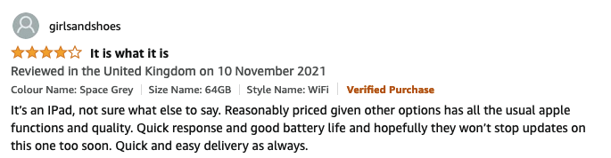
Annotation on the entity/aspect level
This text contains:
Opinions
Targets of opinions
Opinion holder

Slide 21
Annotation on the entity/aspect level
Aspect-based sentiment analysis: find Quintuple (E, A, S, H, C)
E: opinion target (entity, event or topic)
A: aspect or feature of E
S: sentiment/opinion content (phrase or a sentiment score of A)
H: opinion holder
C: context; time and location of the expression
Notes:
Finding all 5 elements is not easy, not all present in the same sentence for example
(E, A, S, H, T)
(iphone,touch screen,+2,I,unknown)

Slide 22
Example of a Product Review
(E, A, S, H, C)

Slide 23
Example of a Product Review
(E, A, S, H, C)
(ipad, price, reasonable, girlsandshoes, (UK, 10 November 2021))
(ipad, battery life, good, girlsandshoes, (UK, 10 November 2021))

Slide 24
detect (E,A,S,H,C) in document D
E: entity, event or topic → Named Entity Recognition /Event Detection, or get from the metadata (in the case of a product review)
A: aspect or feature of E → Information Extraction / aspect categorization
This camera is expensive → implicit aspect ‘price’
Aspects are domain dependent and can be challenging to extract

Slide 25
detect (E,A,S,H,C) in document D
S: sentiment of A → sentiment classification; or opnionated phrase extraction
H: opinion holder
In tweets and reviews: usually the author
But can also be present in the text: → Named Entity Recognition
“Look what other countries are doing now about adopting a booster campaign virtually for everybody. I think if we do that … by the spring we can have pretty good control of this,” Fauci said.

Slide 26
detect (E,A,S,H,C) in document D
C: context: time and location of the expression
Date /location stamp of tweet, blog or review
But can also be present in the text: → Time expression Recognition
or Geolocation classication / NER

Slide 27
Challenges

Slide 28
Example
“This past Saturday, I bought a Samsung phone and my girlfriend bought a HTC phone with 3D touch. We called each other when we got home. The voice on my phone was not so clear, worse than my previous phone. The battery life was long. My girlfriend was quite happy with her phone. I wanted a phone with good sound quality. So my purchase was a real disappointment. I returned the phone yesterday.”
Which challenges for sentiment analysis do you identify in this review text? Discuss with your neighbour

Slide 29
Example
This past Saturday, I bought a Samsung phone and my girlfriend bought a HTC phone with 3D touch. We called each other when we got home. The voice on my phone was not so clear, worse than my previous phone. The battery life was long. My girlfriend was quite happy with her phone. I wanted a phone with good sound quality. So my purchase was a real disappointment. I returned the phone yesterday.”
comparison: 2 opinion holders, 2 targets
different aspects with different sentiments
co-references
factual statement expressing sentiment
sentiment words not expressing sentiment

Slide 30
Challenges of sentiment analysis
Sentiment words do not always express a sentiment
Detecting an entity+sentiment is not enough:
“Can you tell me which Sony camera is good?”
“If I can find a good camera in the shop, I will buy it.”
However, excluding questions and conditionals would be too easy:
“Does anyone know how to repair this terrible printer?”
“If you are looking for a good car, get an Audi Passat”

Slide 31
Challenges of sentiment analysis
Sentiment words are ambiguous, context- and domain dependent
“This video game is totally unpredictable” vs
“This car is totally unpredictable”
Sarcasm
Notes:
Unpredictable: positive for a roller-coaster of video game, negative for a car, radio

Slide 32
Challenges of sentiment analysis
Objective sentences that express sentiments
“After sleeping on the mattress for two days, a valley has formed in the middle.”
“The washing machine uses a lot of water.”
Notes:
Unpredictable: positive for a roller-coaster of video game, negative for a car, radio

Slide 33
Evaluation

Slide 34
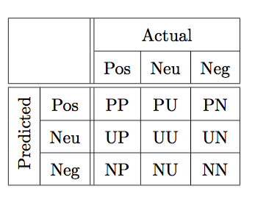
Evaluation of sentiment analysis
In case of three labels: Positive(P) Neutral(U) Negative(N)
Precision_{pos} =
Recall_{pos} =

Slide 35
Evaluation of sentiment analysis
In case of three labels: Positive(P) Neutral(U) Negative(N)
Precision_{pos} = PP / (PP+PU+PN)
Recall_{pos} = PP / (PP+UP+NP)

Slide 36
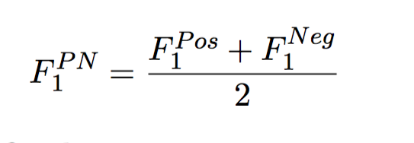
Evaluation of sentiment analysis
In case of three labels: Positive(P) Neutral(U) Negative(N)
Precision_{pos} = PP / (PP+PU+PN)
Recall_{pos} = PP / (PP+UP+NP)
F₁^{pos} = 2 * (P_{pos} * R_{pos})/(P_{pos}+ R_{pos})
Average F-score is computed on positive and negative labels only:

Slide 37
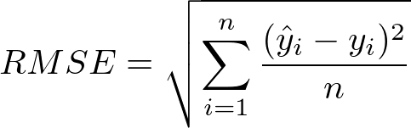
Evaluation of sentiment analysis
In case of regression:
Root Mean Squared Error (RMSE)
Correlation metric: Pearson/Spearman correlation coefficient (r)

Slide 38
Example research
Sentiment analysis on tweets

Slide 39
Semeval
Sentiment analysis benchmark competition on Twitter data
2018: 75 teams participated
Task 1: Affect in Tweets
1. emotion intensity regression
2. emotion intensity ordinal classification
3. valence (sentiment) regression
4. valence ordinal classification
5. emotion classification
Mohammad, S., Bravo-Marquez, F., Salameh, M., & Kiritchenko, S. (2018). Semeval-2018 task 1: Affect in tweets. In Proceedings of The 12th International Workshop on Semantic Evaluation (pp. 1-17).
Notes:
I

Slide 40
Dataset creation
For each emotion X, they manually selected 50 to 100 terms that are associated with that emotion at different intensity levels.
E.g. for anger: angry, mad, frustrated, annoyed, peeved, irritated
Term sources: Roget’s Thesaurus, nearest neighbors in a word embeddings space, and emoticons

Slide 41
Dataset creation
For each emotion X, they manually selected 50 to 100 terms that are associated with that emotion at different intensity levels.
E.g. for anger: angry, mad, frustrated, annoyed, peeved, irritated
Term sources: Roget’s Thesaurus, nearest neighbors in a word embeddings space, and emoticons
They then retrieved tweets from the Twitter API that include these terms

Slide 42
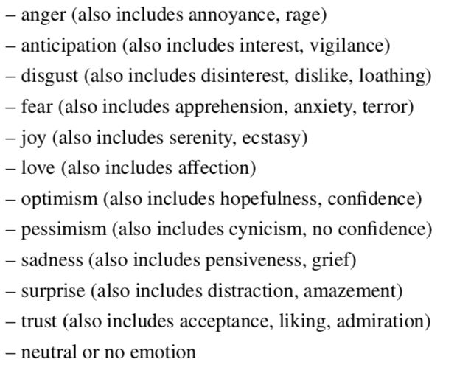
Annotation
Crowdsourcing
About 5% of the tweets in each task were annotated internally beforehand (‘gold tweets’) to control the quality
“which of the following options best describes the emotional state of the tweeter”
7 annotations per tweet; 174,356 in total

Slide 43
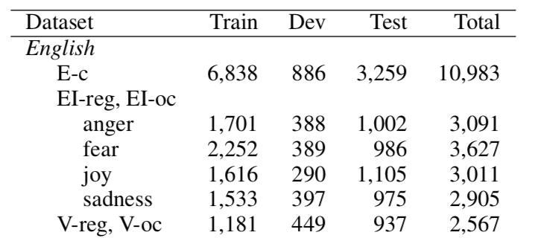
Resulting data
Emotion classification (E-c)
Emotion intensity regression (EI-reg)
Emotion intensity ordinal classification (EI-oc)
Valence (sentiment) regression (V-reg)
Valence ordinal classification (V-oc)

Slide 44
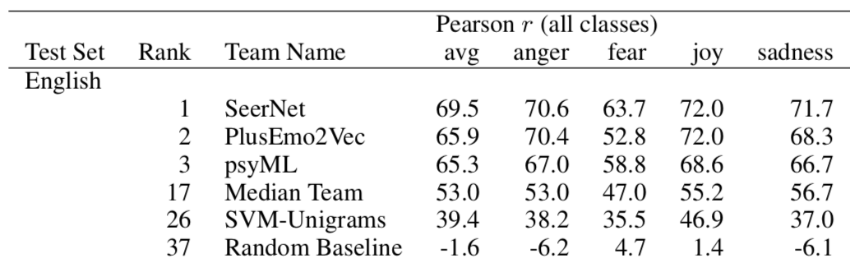
Results
Summary of results for emotion intensity ordinal classification (EI-oc)
Notes:
Classifier: SVM with linear kernel

Slide 45
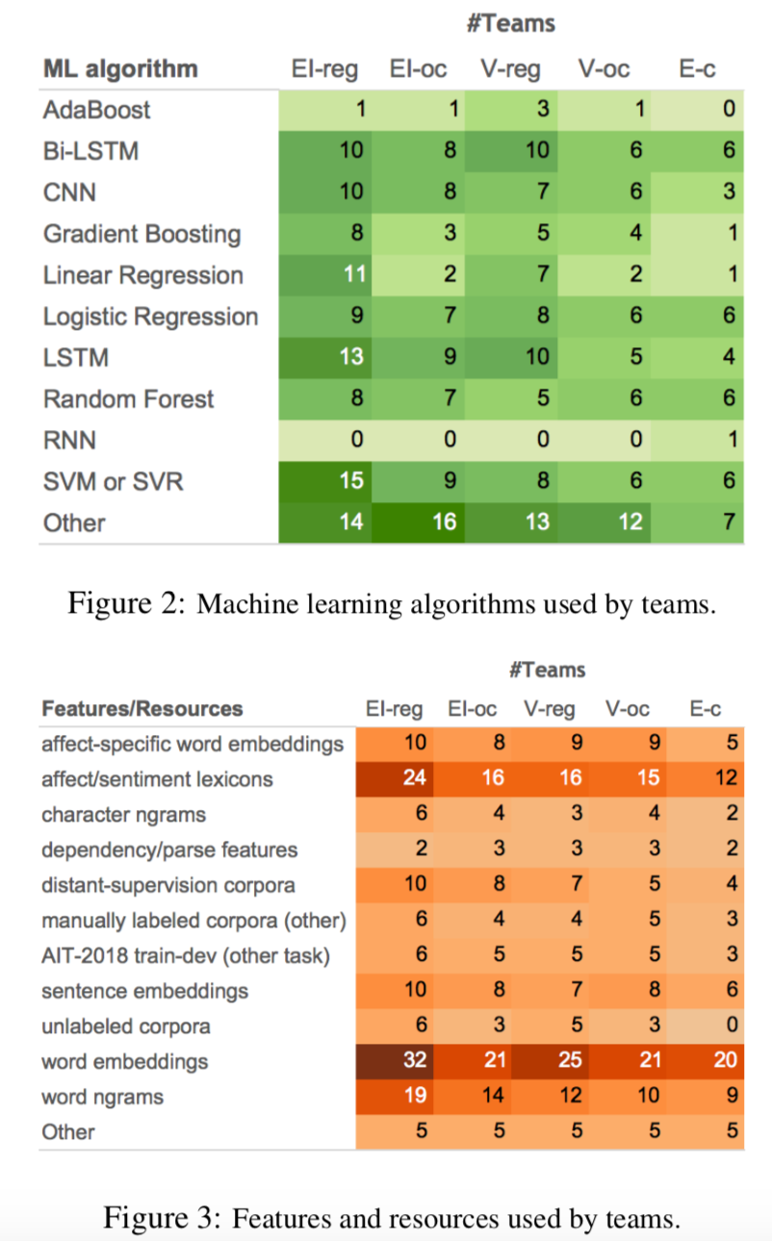
Methods and features used
“Most of the top-performing teams relied on sentence embeddings as well as features derived from existing sentiment and emotion lexicons.”

Slide 46
Conclusions of SemEval
“This shows that despite being rather powerful, representation learning can benefit from working in tandem with task-specific features.”

Slide 47
Final Assignment

Slide 48
About the final assignment
Topics to choose from:
Text Classification
Information Extraction
Sentiment Analysis
Argument mining
Data: provided by us
Experiments: choose your own method. You can build on tutorials
Report: 8 pages + max 2 pages for references and appendix (research paper). Advice: use LaTeX on Overleaf
Deadline: January 16.

Slide 49
Topics
A description of the topics and the data will be given in next week’s lecture.
You are allowed to propose your own topic. In that case, submit a proposal on or before December 1st:
One paragraph describing the task (with one or two references to papers)
Your research question(s)
A reference to the data and a table summarizing the data set size
We will provide feedback on this

Slide 50
Research paper structure
Introduction
Background/related work
Data
Methods
Results
Discussion
Conclusion
Contributions of the team members
(Grading criteria can be found on Brightspace: Assignments -> Criteria for final assignment)

Slide 51
Deadlines
(December 1: proposal for your own topic; if you want to)
December 6: select a topic (choose one of four)
You don’t have to send this to us
December 15: submit a draft of your introduction and data description sections.
You receive 1 point out of the 10 for the final assignment by completing this step.
January 16: submit the full paper
If your submission is late, then it will be counted as re-sit (maximum grade: 6). The re-sit deadline is January 31st.
Everything can be submitted to the Brightspace item ‘Final assignment’

Slide 52
Conclusions

Slide 53
Homework
Exercise week 9: sentiment analysis
Follow the tutorial on: https://skimai.com/fine-tuning-bert-for-sentiment-analysis/
Make sure you understand what the steps mean
There is no assignment on this, but you can choose sentiment analysis as topic for the final assignment

Slide 54
Homework
Exercise week 9: sentiment analysis
Follow the tutorial on: https://skimai.com/fine-tuning-bert-for-sentiment-analysis/
Make sure you understand what the steps mean
There is no assignment on this, but you can choose sentiment analysis as topic for the final assignment
No literature reading this week, so you can catch up on the literature of week 6 and 7:
J&M chapter 7. Neural Nets and Neural Language Models
J&M chapter 8. Sequence Labeling for Parts of Speech and Named Entities
J&M chapter 9. Deep Learning Architectures for Sequence Processing
J&M chapter 17. Information Extraction

Slide 55
After this lecture…
You can name the different types of sentiment analysis
You can define the components of aspect-based sentiment in texts
You can list the features that are used in state-of-the-art sentiment analysis methods
You can explain the challenges of sentiment analysis
You can correctly evaluate sentiment analysis

